Slide 1
Respiratory System

Slide 2
1. Identify the organs forming the respiratory passage-way in descending order until the alveoli are reached.
Nasal cavity
Nasopharynx
Oropharynx
Laryngeal pharynx
Larynx & Vocal Chords
Trachea
Right and Left
Primary bronchus
Secondary bronchus
Tertiary bronchus
Bronchioles
Alveolar ducts
alveoli

Slide 3
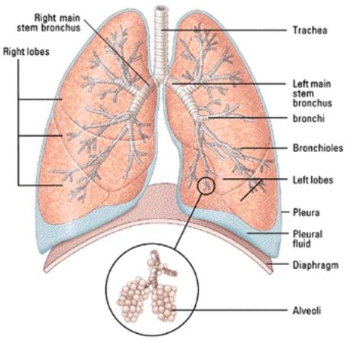

Slide 4
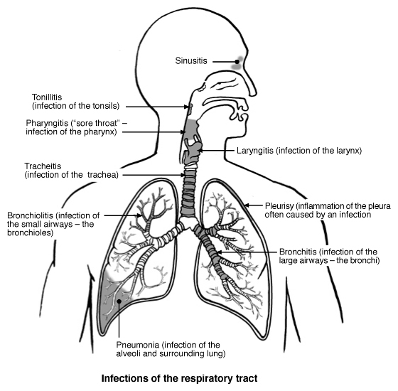

Slide 5
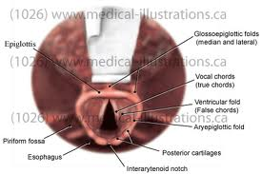

Slide 6
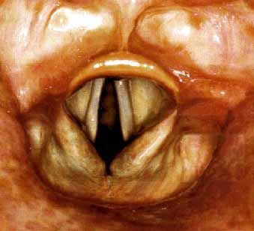

Slide 7
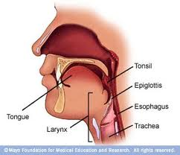

Slide 8
Singing Vocal Chords
http://www.youtube.com/watch?v=b_rRHPn8PS4&feature=related
https://www.youtube.com/watch?v=Cwnpg0tK_8Q
Esophagus vs. trachea
http://www.youtube.com/watch?v=JZ9kGLG-Tdg

Slide 9
2. Describe several protective mechanisms of the respiratory system.
Foreign bodies such as dust particles and pathogens are filtered out by the hairs of the nostrils or caught I the surface mucus
Air is warmed by the blood in the vascular mucus membrane and moistened by the liquid secreted by the mucus membrane
Epiglottis flap covers the glottis so food does not go into the trachea
The bronchi are lined with epithelial cells that have cilia to filter our impurities
Cells in the alveoli produce surfactant that reduces surface tension and prevents collapse and aides in expansion
Alveolar macrophages are the primary WBC that protect the lung against inhale or aspirated microbes

Slide 10
LUNGS
http://www.youtube.com/watch?v=GERsMFWYZrw&feature=Playlist&p=71A952F5381FFCDE&index=2

Slide 11
OXYGEN EXCHANGE
http://www.youtube.com/watch?index=6&feature=Playlist&v=WXOBJEXxNEo&list=PL71A952F5381FFCDE

Slide 12
3. Describe the makeup of the respiratory membrane & relate its structure to it function.
Nasal passages are lined with a mucus membrane containing many blood vessels
-deliver heat & moisture
Lung membranes are psuedostratified columnar epithelial cells with cilia projection
-clean respiratory passages
The membranes of the alveoli are simple squamous
-allow diffusion of oxygen & carbon dioxide

Slide 13
4. Describe the structure & function of the lungs & pleural coverings.
Lungs are located in the thoracic cavity. Extends from just above the clavicles to the diaphragm
A double sac called the pleura cover each lung
Parietal pleura- attaches to the chest wall
Visceral pleura- attaches to lung surface
Intrapleura space- (is btw the two) a thin film of serous fluid lubricates & allows expansion

Slide 14
http://www.youtube.com/watch?v=noDxydboLrA&feature=related
http://www.youtube.com/watch?v=-qAnqeg0zHg&feature=related

Slide 15
5. Explain the relative roles of the respiratory muscles & lung elasticity in effecting volume changes that cause air to flow into and out of the lungs.
Lung Tissue is elastic
Movement of the thoracic cavity walls causes movement of lung walls, changing the lung volume. Compliance measures ease of lung expansion and contraction.

Slide 16
Boyle’s Law- Pressure of a given quantity of gas is inversely proportional to its volume.
As lung volume increases on inhalation the intrapulmonic pressure (P2) decreases air flow into the lungs.
On exhalation, lung volume decreases, intrapulmonic pressure (P2) increases, and air flows out of the lungs.

Slide 17
Diaphragm Dome- shaped skeletal muscle that forms floor of thoracic cavity.
Inspiration-Contraction of diaphragm causes it to flatten & lengthen the pleural cavities, thus increasing intrathoracic volume. Lungs expand, decreasing intrapulmonary (alveolar)pressure within lungs & air flows in (tidal volume) Active Process.
Expiration- expiration diaphragm relaxes & shortens pleural cavities, thus decreasing intrathoracic volume. Lungs elastically recoil, chest wall, & abdominal organs compress lungs, increasing intrapulmonary pressure & air flows out, Passive Process. Contraction of abdominal muscles during forced breathing causes rapid expiration, active process.

Slide 18
Ribs form walls of thoracic cavity.
Inspiration Contraction of external intercostal muscles pull ribs & sternum upward and outward, increases anterior-posterior thoracic diameter by 20%. Active Process. Contraction of sternocleidomastoids, scalenes, & pectoralis minor further elevate upper ribs during forced inspiration.
Expiration external intercostals relax, ribs & sternum move downward and inward, decreases anterior- posterior diameter. Passive Process. Internal intercostals and abdominal muscle layers contract during forced expiration. Active Process.

Slide 19
6. Explain the function importance of the partial vacuum that exists in the intrapleural space.
Airtight thoracic cavity divided into 2 pleural cavities containing lungs.
Pleural Cavity is lined with parietal pleura & lungs are covered with visceral pleura, intrapleural pressure < atmospheric pressure helps them to adhere together.
Pleural fluid secreted by the pleural membranes fills the small space between the pleura and helps the pleura slide over each other but not pull apart

Slide 20
7. Describe several physical factors that influence pulmonary ventilation.
Pulmonary ventilation is the inflow and outflow of air between the lungs & atmosphere (breathing)
Patency of the airway (solid obstructions or mucus)
Compliance of the bronchial tubes and alveoli
Ability for diaphragm and intercostals muscle to contract

Slide 21
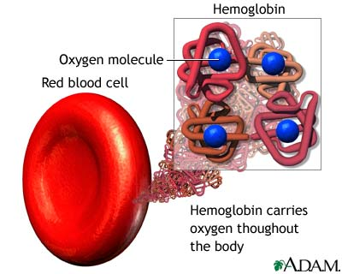
9. Describe how oxygen & carbon dioxide are transported in the blood.
Oxygen that diffuses into capillary blood in the lungs is bound by the hemoglobin of the RBC.

Slide 22
Transportation of Carbon Dioxide
A by product of metabolism
10% dissolved in the plasma
20% combined with the protein portion of hemoglobin and plasma protein
70% is transported as bicarbonate ion formed when CO2 dissolves in blood fluid

Slide 23
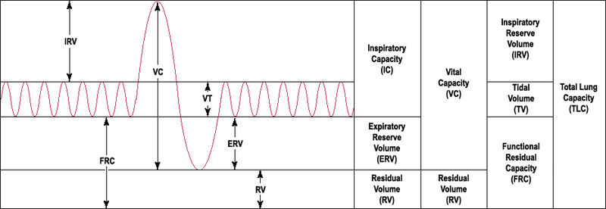
8. Explain & Compare the various lung volumes & capacities. Indicate types of information that can be gained from pulmonary function tests.

Slide 24
Total lung capacity (TLC)= 6.0 L=
IRV + Vt + ERV + RV
The volume of air contained in the lung at the end of maximal inspiration. The total volume of the lung (i.e.: the volume of air in the lungs after maximum inspiration.)

Slide 25
Vital capacity (VC)= 4.6 L=
IRV + Vt + ERV
The amount of air that can be forced out of the lungs after a maximal inspiration. Emphasis on completeness of expiration. The maximum volume of air that can be voluntarily moved in and out of the respiratory system.

Slide 26
Forced vital capacity (FVC)= 4.8 L
Measured
The amount of air that can be maximally forced out of the lungs after a maximal inspiration. Emphasis on speed.

Slide 27
Tidal Volume (Vt)= 500 mL
Measured
The amount of AIR breathed in or out during normal RESPIRATION. The volume of air an individual is normally breathing in and out.

Slide 28
Residual volume (RV) = 1.2 L
Measured
The amount of air left in the lungs after a maximal EXHALATION. The amount of air that is always in the lungs and can never be expired. (i.e.: The amount of air that stays in the lungs after maximum expiration)

Slide 29
Expiratory reserve volume (ERV)= 1.2 L
Measured
The amount of additional air that can be pushed out after the end expiratory level of normal breathing. (At the end of a normal breath, the lungs contain the residual volume plus the expiratory reserve volume, or around 2.4 liters. If one then goes on and exhales as much as possible, only the residual volume of 1.2 liters remains.)

Slide 30
Inspiratory reserve volume (IRV)= 3.0 L
Measured IRV=VC-(TV+ERV)
The additional air that can be inhaled after a normal tidal breath in. The maximum volume of air that can be inspired in addition to the tidal volume.

Slide 31
Functional residual capacity (FRC)= 2.4 L=
ERV + RV
The amount of air left in lungs after tidal breath out. The amount of air that stays in the lungs during normal breathing.

Slide 32
Inspiratory Capacity (IC)= 3.5 L=
TV + IRV
The maximal volume that can be inspired following a normal expiration.

Slide 33
Anatomical dead space= 150 mL
Measured
The volume of the conducting airways. Measure with FOWLER METHOD

Slide 34
Physiologic dead volume= 155 mL
The anatomic dead space plus the alveolar dead space.

Slide 35
10. Describe the neural controls of respiration.
Respiratory control center in the medulla and pons of the brain
From the medulla motor nerve fibers extend into the spinal cord through the phrenic nerve to the diaphragm
Chemoreceptors located in the carotid & aortic bodies as in the medulla
Kept in pace moment to moment by changes in cellular oxygen requirements & CO2 production & hydrogen ion levels

Slide 36
11.Name several physical factors that influence respiratory rate.
Anxiety
Exercise
Awakefullness
Drugs
Activity level

Slide 37
12. Describe the symptoms & probable causes of Chronic Obstructive Pulmonary Disease & lung cancer.
Chronic Obstructive Pulmonary Disease- (COPD)- includes two lung conditions- Chronic bronchitis & emphysema.
About 50% to 90% of COPD cases are thought to be due to smoking.

Slide 38
Chronic Bronchitis
Inflammation in the airways leading to & within the lungs (bronchial tubes). The inflammation may narrow these tubes, which makes it hard to breathe.
Chronic Bronchitis causes a persistent cough that brings up mucus (sputum).

Slide 39
Emphysema
Long term (chronic), irreversible lung disease that occurs when the tiny air sacs in the lungs are damaged, usually as a result of long term smoking. It causes difficulty breathing & shortness of breath that gets worse over time.
A rare type of emphysema is caused by the lack of a substance in the lungs called alpha1-antitrypsin. This type of emphysema is usually inherited.
It may feel as if you can’t get air in, but in fact, air is trapped in lungs

Slide 40
COPD
More than 12 million people in the US have COPD, but another 12 million have COPD without knowing it. COPD symptoms are sometimes DISMISSED as smokers cough.
COPD is the 4th leading cause of death

Slide 41
Emphysema symptoms
Emphysema is caused by destruction of alveoli, small sac-like structures in the lungs where oxygen from the air is exchanged for carbon dioxide in the blood.
As a result of damage, the fragile alveolar walls become filled with holes. Destruction of alveolar walls lead to less surface area gas exchange, which leads to less oxygen in blood. The loss of elasticity also leads to air becoming trapped in the lungs, resulting in too much carbon dioxide in the blood.

Slide 42
http://www.youtube.com/watch?v=SaeJUCVEp2s

Slide 43
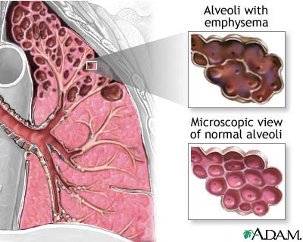

Slide 44
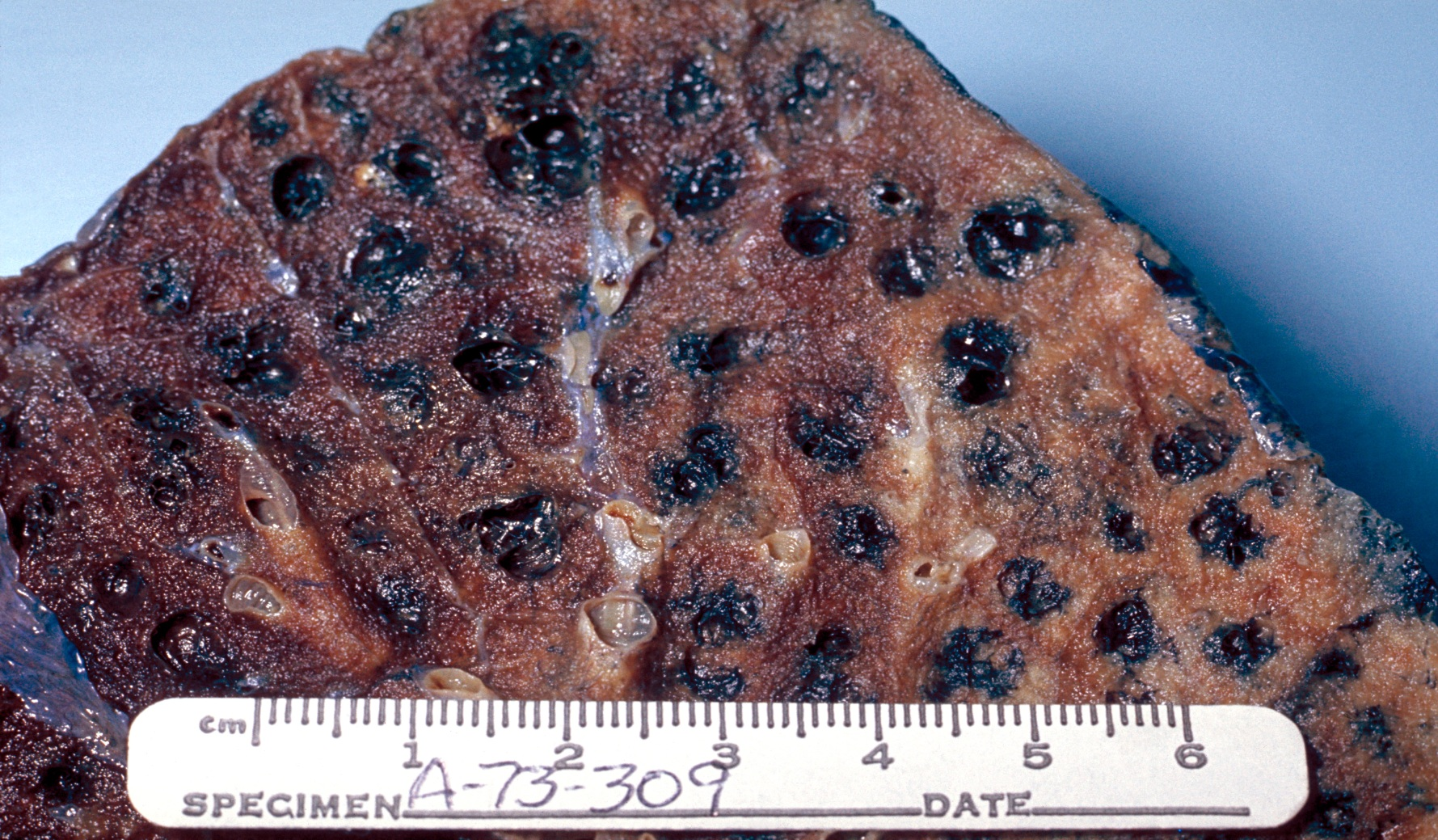
Gross pathology of lung showing centrilobular emphysema characteristic of smoking.

Slide 45
Lung Cancer
Symptoms of lung cancer vary depending on the type, location, and size of tumor.
Many people with lung cancer have no symptoms until the disease has advanced into late stages.
Some lung cancer symptoms are similar to those of other common illnesses. Advise your physician of your medical & social history at each physical examination to assist in a prompt and accurate diagnosis.

Slide 46
When lung cancer does cause symptoms, they can include the following:
Coughing (most common)
Shortness of Breath (dyspnea)
Fatigue
Wheezing
Pain in the chest, shoulder, upper back, arm
Coughing up blood (hemoptysis)
Repeated pneumonia or bronchitis
Loss of appetite (anorexia) or weight loss
General pain
Hoarseness
Swelling of face or neck
Pleural effusion

Slide 47
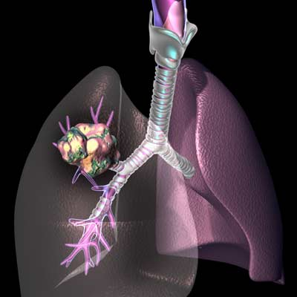

Slide 48
13. Describe normal changes that occur in respiratory system functioning from infancy to old age.
With age lung tissue lose elasticity and become rigid
Muscle strength weakens & arthritis leads to chest wall rigidity
Immune system not working as well leads to increased infection
Increased emphysema due to exposure

