Slide 1
1. Identify on a cell model or diagram the cell organelles and be able to explain their function

Slide 2
Cytoplasm
Surrounds and supports organelles
Medium through which nutrients and waste move

Slide 3
Nucleus
Center of the cell
Contains genetic information
Chromosomes with the genes which are the hereditary material that directs all cell activity

Slide 4
FYI mature red blood cells have no nucleus
Immature RBCs do at first but they go away. It allows the red blood cell to contain more hemoglobin and, therefore, carry more oxygen molecules. It also allows the cell to have its distinctive bi-concave shape which aids diffusion. This shape would not be possible if the cell had a nucleus in the way.

Slide 5
Nucleolus
Small body in the center of the nucleus
r RNA is transcribed from DNA and assembled into ribosomes (site of protein synthesis)
The more protein a cell needs the larger the nucleolus

Slide 6
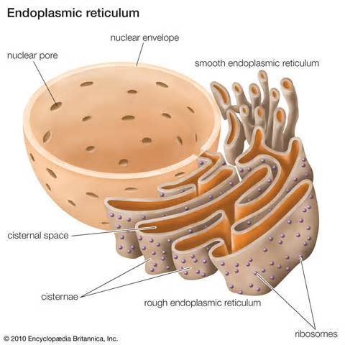
Endoplasmic Reticulum ER
Network of membranes in the cytoplasm used for storage and transport
Rough ER-Holds ribosomes
where protein is synthesized
Smooth ER-Site of steroid
synthesis

Slide 7
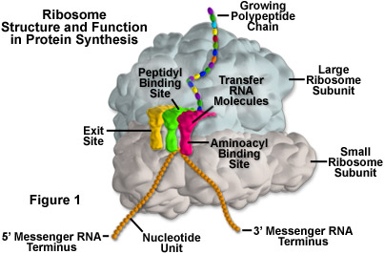
Ribosomes
Small bodies attached to ER composed of protein and RNA
Site of protein synthsis

Slide 8
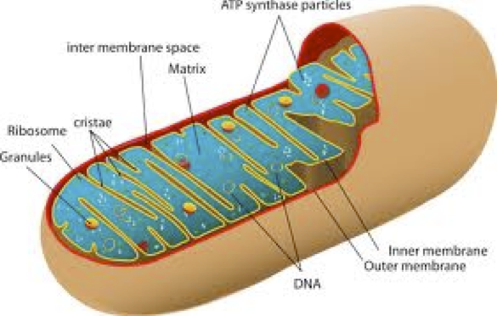
Mitochondria
Large organelles with folded membranes inside
Convert energy from
Nutrients into ATP
Power plant of the cell

Slide 9
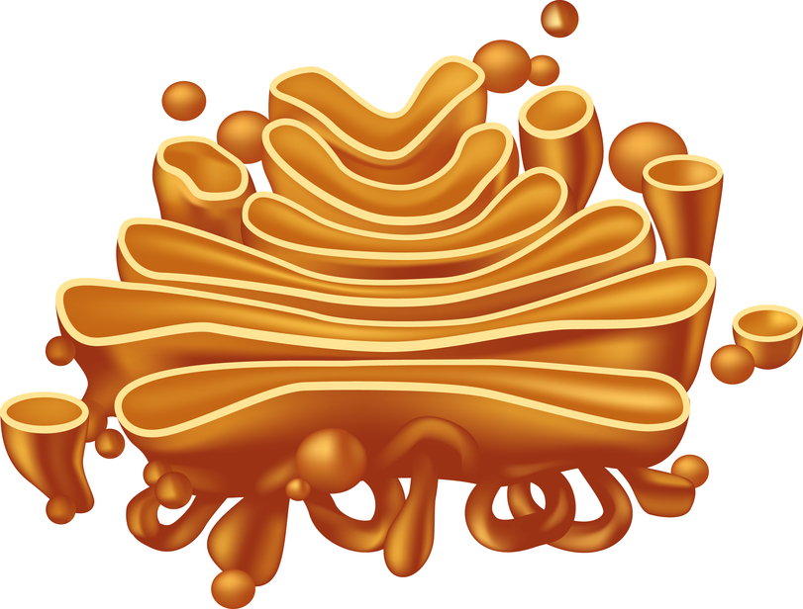
Golgi Apparatus
A series of flattened membrane sacs
Protein synthesized along the rough ER are transported to the Golgi through channels in the ER
The Golgi puts the finishing touches on the protein and packages it for secretion

Slide 10
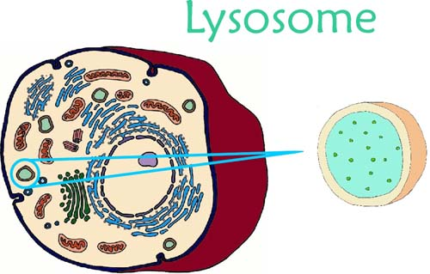
Lysosomes
Digestive organelles
Contains powerful enzymes
Break down intracellular debris
and clean house through phagocytosis

Slide 11
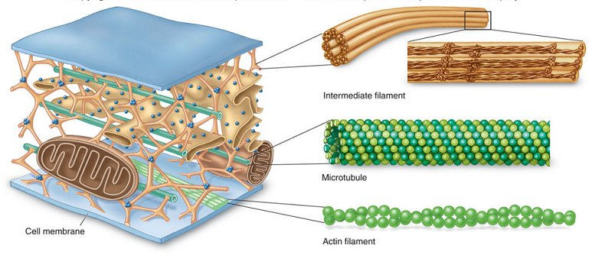
Cytoskeleton
Thread like structure called microfilaments and microtubules
Helps cell maintain shape and assisted
with various movements
for example in muscle
movement

Slide 12
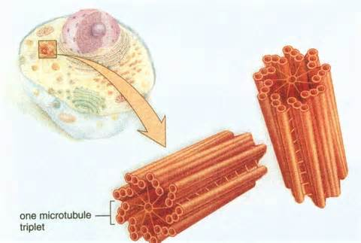
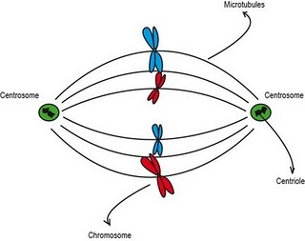
Centrioles
Paired, rod-shaped
microtubule structures
Help separate the
chromosomes in cell division

Slide 13
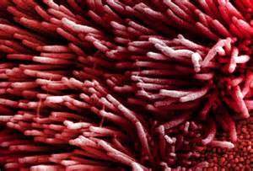
Cilia
Short hair like projections present in some cells
Create movement
around the cell
Example cells lining
the lungs

Slide 14
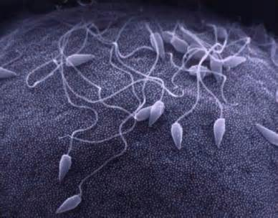
Flagellum
Long whip-like extensions that move the cells
Example the sperm cells

Slide 15
https://www.youtube.com/watch?v=URUJD5NEXC8

Slide 16
2. Describe the structure of the plasma membrane, and explain how the various transport process account for the directional movements for specific substances across the plasma membrane

Slide 17
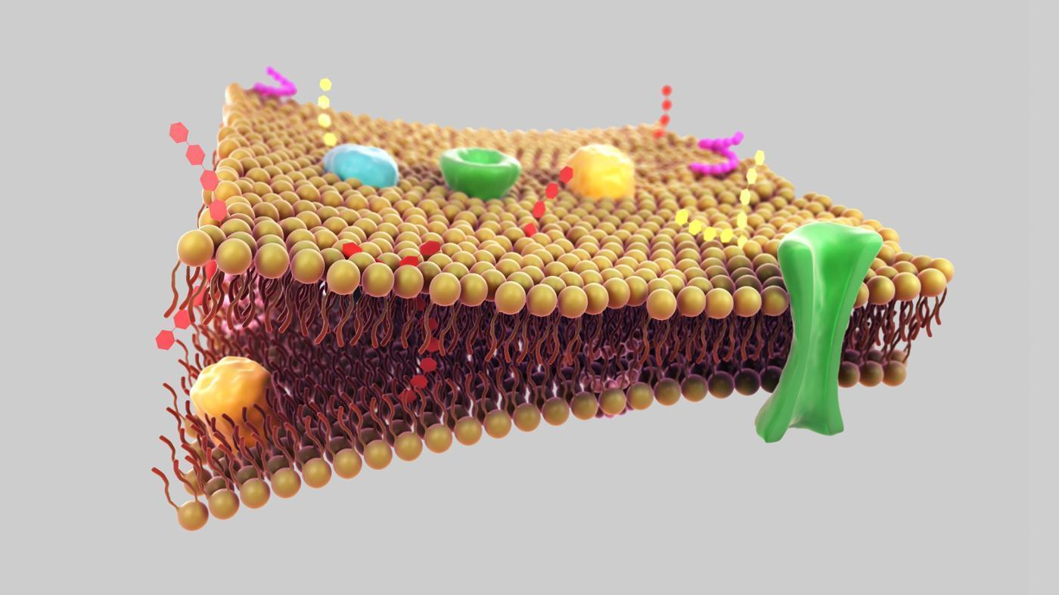
Cell Membrane
Phospholipids
Cholesterol
Glycoproteins
Pore proteins
Channel proteins
Receptor proteins

Slide 18
Phospholipid
Major component of all cell membranes
Two hydrophobic fatty acid "tails" and a hydrophilic phosphate "head", joined
Holds the cell together

Slide 19
Cholesterol
Stabilizes the cell wall
Maintains the boundary of the cell membrane

Slide 20
Glycoprotein
Act as makers for the cell as an identifier of what that cells is
Like a name tag

Slide 21
Pore Protein and Channel Proteins
Channels or carriers of molecules
Controls transport of water soluble molecules from one compartment to another

Slide 22
Receptor proteins
Trigger metabolic changes in cell membrane
Sensitive to hormones, neurotransmitters, enzymes and medication
https://www.youtube.com/watch?v=p5zFgT4aofA

Slide 23
https://www.youtube.com/watch?v=Pfu1DE9PK2w

Slide 24
3. Describe different cell types and explain the functionality of the differences
The average adult has about 15 trillion cells
Stretched end to end they would stretch around the earth 47 times
If you could count them at rate of on e cell per second, it would take you aver 2600 years
The largest human cell is the egg cell about the diameter of a hair
The smallest is the sperm cell
In humans, there are about 200 different types of cells

Slide 25
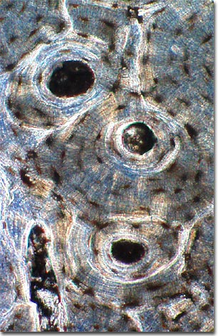
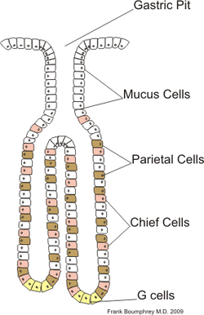
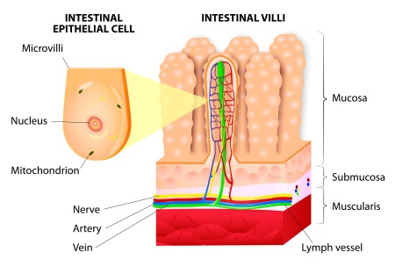
Each type of cell is designed to do a different job
Red cells carry oxygen through out the body https://www.youtube.com/watch?v=UhqcB34AwpU
Nerve cells carry electrical signals to and from our brain and to our muscles all over the body https://www.youtube.com/watch?v=CLS84OoHJnQ
Bone cells, which are very Rigid form the skeleton that gives our body shape
Muscle cells Contract to move these bones to help us get around
https://www.youtube.com/watch?v=gJ309LfHQ3M
Stomach cells Secrete an acid digest our food
Special cells in the intestines absorb nutrients from the food that we eat

Slide 26
4. Describe the cell cycle, including the phases of mitosis, and explain how timing of cell division is regulated
https://www.youtube.com/watch?v=g7iAVCLZWuM

Slide 27
Interphase
Technically not part of mitosis, but it is included in the cell cycle
Has 3 phases G1, S, G2
Cell is in a resting phase, performing cell functions
DNA replicates (copies itself)
Organelles double in number, to prepare for division

Slide 28
Prophase
Spindle form
Centrioles move to opposite poles
Chromosomes become visible

Slide 29
Metaphase
Chromosomes line up along the equator

Slide 30
Anaphase
Centromeres divide
Chromatids separate and move to opposite poles

Slide 31
Telophase
Nuclear membrane forms around each group of chromosome
Chromosomes unwind
Cytokinesis begins

Slide 32
Cytokinesis
The process by which the cytoplasm divided and one cell becomes two individual cells

Slide 33
5. Have an understanding of stem cells and how they are used in modern medical procedures and research.
Three groups of cells
Prolific stem cells
Reversible stem cells
Permanent stem cells

Slide 34
Prolific stem cells
Cells that constantly go through the cell cycle in order to replace worn out cells
Epithelial cells are an example

Slide 35
Reversible stem cells
Cells that go into a growth arrested state known as Go, but if needed, they can go back into G1 and form new daughter cells when the tissue is damaged
Example is liver cells

Slide 36
Permanent stem cell
These cells go into a growth arrested state known as Go after the tissue is mature. Even if the cells die or are damaged beyond repair within the tissue, they cannot be replaced
Two examples
Neurons
Cardiac muscle

Slide 37
https://www.youtube.com/watch?v=1q2zUBBh4fU

Slide 38
6. Name the four primary classes of human tissue and explain how they differ structurally and functionally 7. Know the anatomical location of the different tissue types

Slide 39
Epithelial
purpose: Covering surfaces, lines cavities, form glands
functions: Protects surfaces i.e.. Skin, Sensory functions, secretion, absorption, excretion
squamous cells- flat irregular (vessel walls, alveoli, kidney)
cuboidal- square (kidney tubules, thyroid, pancreas, salivary glands)
columnar- long and narrow (digestive track)
Simple – one layer (lining of resp. track, lining of reproductive tubes)
pseudostratified columnar-one layer but nucleus is unevenly placed giving the false appearance of stratified
Stratified- many layers (skin, lining of mouth esophagus, anus, vagina)
Transitional epithelial- (cells that are able to change size such as urinary bladder)

Slide 40
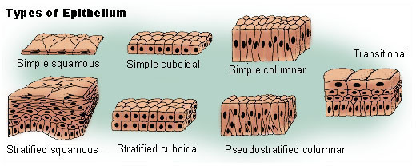

Slide 41
Connective tissue most wide spread and variable of the tissues: elastic sheets, tough cords, delicate webs, rigid bone, fluid
Fibrous
Loose Areolar (superficial fascia)
Adipose (fat under skin)
Reticular (spleen, lymph nodes, bone marrow)
Dense Fibrous
Irregular ( deep facia, dermis, scars)
Regular (tendons, ligaments, aponeuroses)
Elastic ( walls of some arteries)
Bone
compact bone (skeletal outer shell)
spongy bone (inside bone)
Cartilage
Hyaline (nasal septum)
fibrocartilage (vertebral disk)
elastic (external ear)
Blood
leukocytes
erythrocytes
platelets

Slide 42
Muscle
Skeletal- attached to bone, Voluntary
Smooth- stomach, blood vessels, intestines Involuntary
Cardiac- heart Involuntary

Slide 43
Nervous
Two cell types
Neurons- transmit electrical signals
Neuroglia- support and take care of the neurons
Astrocytes- feed neurons by maintaining ion balance and controlling material exchange from blood flow
Oligodendrocytes- creates myelin sheath that insulated and protects neurons
Microglia- phagocytic macrophages that fight of microorganisms
Ependymal- lines the brain and spinal cord where CSF is housed

Slide 44
8. Describe ways the body repairs damaged tissue.
1.
2
3
4
5

Slide 45
9. Identify the various forms of cancer and describe how it affects the body.
http://www.cancercenter.com/discussions/blog/anatomy-of-cancer/
http://www.cancer.org/cancer/showallcancertypes/index
Never give up the fight?

Slide 46
Cancer
Uncontrolled cell growth caused by exposure to carcinogens (tobacco and ultraviolet light) , genetic defects, and viruses
The DNA of the cell mutates
Metastasize-tumor that spreds to surrounding tissue and organs
Malignant- aggressive tumor that metastasizes
200 different types of cancer named for the organ or tissue which they begin to grow

Slide 47
200 different types of cancer named for the organ or tissue which they begin to grow
Leukemia- cancer of the blood
Lymphoma-cancer of the lymphoid tissue
Melanoma-cancer from the melanocytes
Carcinoma- come from epithelial tissue
Sarcomas- come from connective tissue

Slide 48
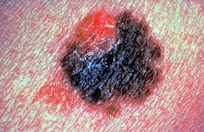
Causes of cancer
Tobacco- Lung cancer is by far the leading cause of cancer death among both men and women; about 1 out of 4 cancer deaths are from lung cancer. Each year, more people die of lung cancer than of colon, breast, and prostate cancers combined. Lung cancer mainly occurs in older people
Ultraviolet sun light-Melanoma kills an estimated
10,130 people in the US annually.

Slide 49
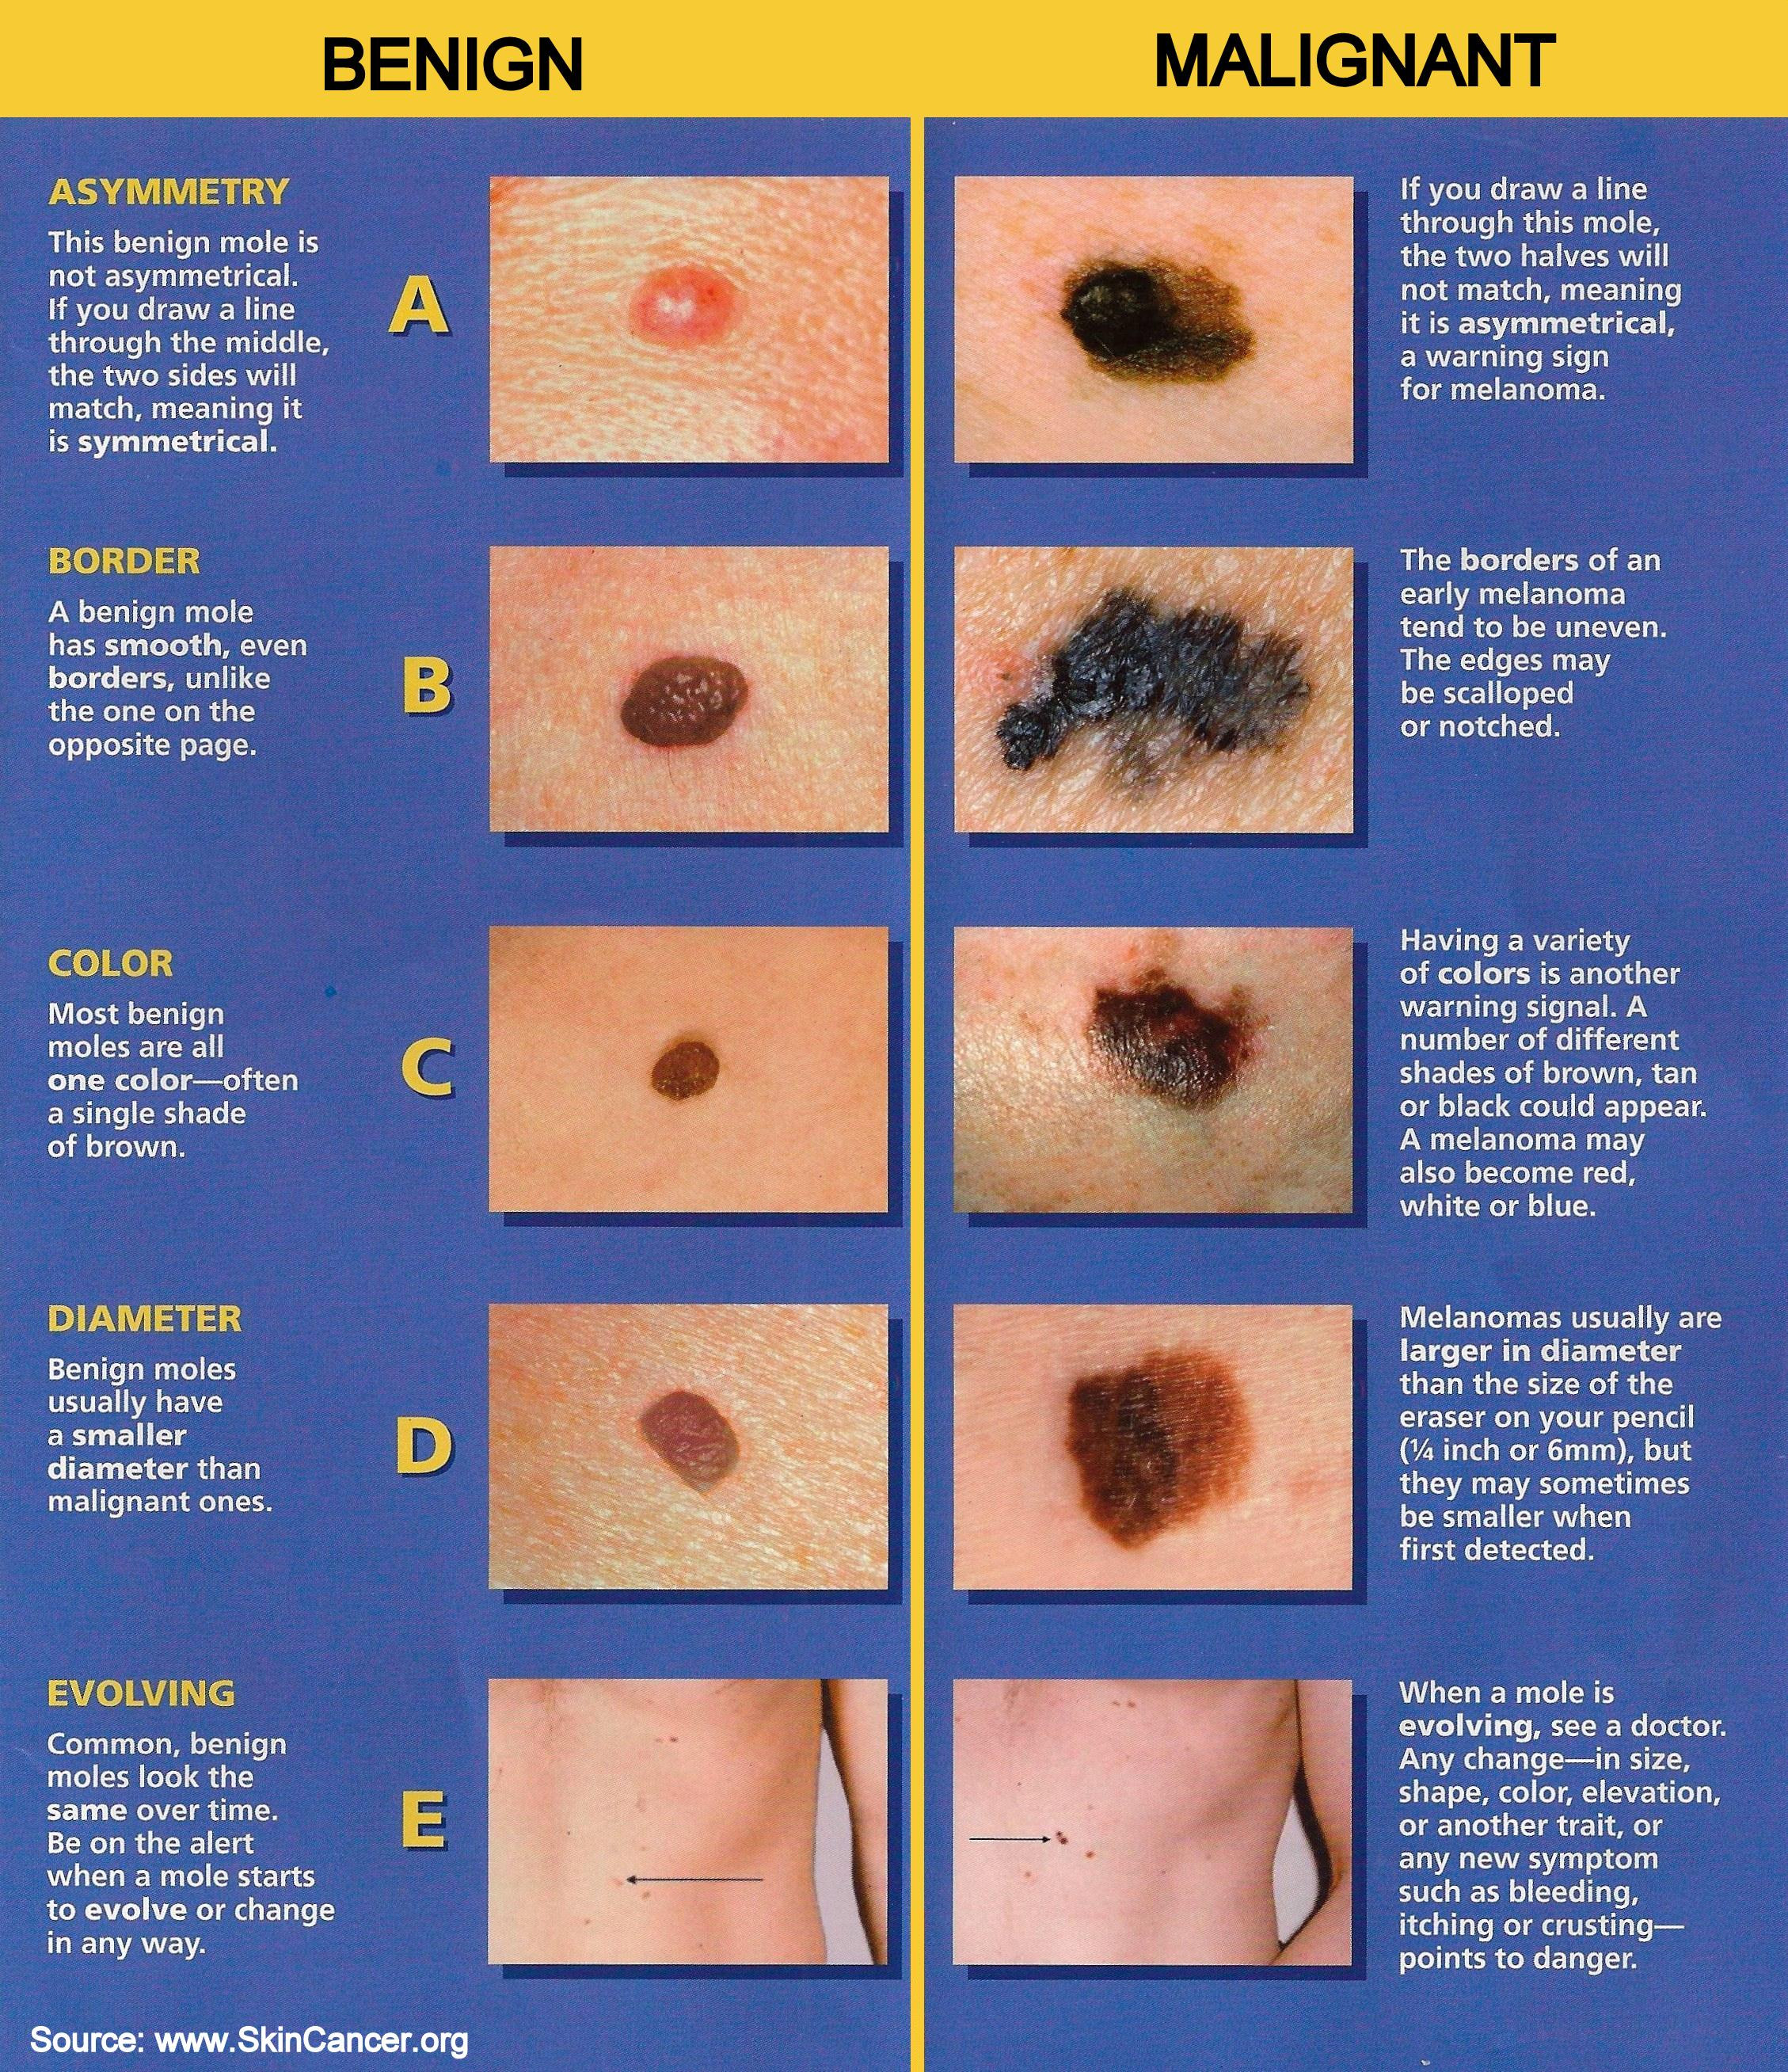

Slide 50
Treatment
Surgical removal
Radiation therapy
Chemotherapy
Boost immune system

Slide 51
Prevention
Avoidance of tobacco
Avoiding overexposure to sun
Avoid high fat foods
Avoid excessive alcohol
Avoid unsafe sex

